Slide 2
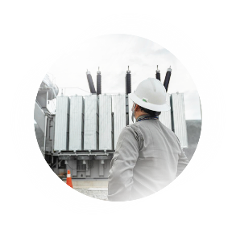
Corporate Governance
1
5
Technical field knowledge
Visible leadership
2
6
Risk perception
Cultural rituals
3
7
Control hierarchies
Information management
4
8
Productivity

Slide 3
CONNECTED TO LIFE
INDUSTRY LEADERSHIP
Leading the safety initiative together with ABRATE and employing joint efforts to change the industry scenario

Slide 4
DISCLAIMER
DISCLAIMER
The statements contained in this report regarding the business outlook of ISA CTEEP (“ISA CTEEP”. “CTEEP”. “Company”). the projections and their growth potential are based on mere forecasts and were based on management's expectations in regarding the Company's future. These expectations are highly dependent on changes in the market. in the general economic performance of the country. the sector and international markets. and are subject to change.
Forward considerations are not performance guarantees. They involve risks. uncertainties and assumptions. as they refer to future events and. therefore. depend on circumstances that may or may not occur.
Investors should understand that general economic conditions. market conditions and other operating factors may affect the future performance of ISA CTEEP and lead to results that differ materially from those expressed in such forward-looking statements.
The financial information was prepared in accordance with CVM (Brazilian Securities and Exchange) rules and CPCs. and it follows international accounting standards (IFRS) issued by the International Accounting Standard Board (IASB). The Regulatory Result is presented in accordance with accounting practices adopted in Brazil. The purpose of disclosing the Regulatory Result is merely to collaborate to understand ISA CTEEP's business. Sums may differ due to rounding. The Regulatory result is audited only at the end of each fiscal year by the independent auditors.

Slide 5
Safety culture
Bruno Laurentys
Energy transition
Luiz Barroso
Growth and sustainability
Rui Chammas
Innovation and opportunities
Silvia Wada
Discipline of structuring and executing projects
AGENDA
Dayron Urrego
Regulatory management (periodic tariff review)
Cláudio Domingorena
Prospects and sustainable value generation
Carisa Cristal

Slide 6
VALUE LEVERS
GROWTH
Consistent and profitable
1
SUSTAINABLE VALUE GENERATION
6
2
OUR STRATEGY
SUSTAINABILITY
Decarbonization and social value generation
Create positive social and environmental impacts
REGULATORY MANAGEMENT
Active management with competitive advantage
Ensure business longevity
Creation of value for shareholders
3
5
INNOVATION
Provider of energy transition solutions
4
EXCELLENCE IN PROJECT MANAGEMENT
Disciplined structuring and execution

Slide 7
VALUE LEVERS
GROWTH
Consistent and profitable
1
SUSTAINABLE VALUE GENERATION
6
2
OUR STRATEGY
SUSTAINABILITY
Decarbonization and social value generation
Create positive social and environmental impacts
REGULATORY MANAGEMENT
Active management with competitive advantage
Ensure business longevity
Creation of value for shareholders
3
5
INNOVATION
Provider of energy transition solutions
4
EXCELLENCE IN PROJECT MANAGEMENT
Disciplined structuring and execution

Slide 8
HOW DID WE GET HERE?
A DECADE OF PROFITABLE GROWTH
STABILIZATION
GROWTH
Permitted Annual Revenue¹ “RAP”
Assets under construction and in operation
(R$ billion)
Acquisition of 1 concession
Full
Start of receipt from Existing Basic Network System “RBSE” (059/2001)
Auction 16 more lots won
2013
2014
2015
2016
2017
2018
2019
2020
2021
2022
2023
Extension of Main Agreement (059/2001) by 30 years
Auction
3 more lots won
Acquisition of 4 concessions
3 Partial and 1 Full
Conclusion of 12 bidded projects
Addition of R$ 644.8 million in Annual Revenue²
¹ RAP nominal cycle, considers RAP from RBSE and Adjustment Portion (PA) of the cycle
² RAP 2023/2024 cycle, baseline June 2023

Slide 9
1
GROWTH
Consistent and profitable
TRACK RECORD OF PROFITABLE GROWTH
Balanced mix of revenue from renewed and bidded agreements
RAP ASSETS UNDER OPERATION (ex-RBSE)¹
Revenue by type of agreement
R$ million
Diversification by type of agreement
CAGR²: 9.2%
2013/2014 Cycle
2023/2024 Cycle
CAGR²: 17.0%
CAGR²: 12.7%
R$866
million
R$2,866
million
CAGR² IPCA in the period: 6.1%
Agreement renewed (059)
Bidded agreements in operation
¹ Considers Adjustment Portion (PA) | ² CAGR: Compound Annual Growth Rate

Slide 10
1
GROWTH
Consistent and profitable
CONSISTENT GROWTH
A DECADE OF EXPANSION AND DIVERSIFICATION
2013
2023
Market Share¹ total RAP
9.0%
+306 bps
12.1%
Average expiry Concessions²
Jun/41
+52 months
Oct/45
Concessions
15
+133%
35
Own substations³
107
+28%
137
Transformation capacity³
46,000 MVA
+ 86%
85,000 MVA
Transmission lines³
14,000 km
+ 113%
23,000 km
¹ List of ANEEL modules 2023/2024 + Auctions 02/2022 and 01/2023, baseline June/23 | ² Weighted by RAP, excluding RBSE | ³Assets in operation and under construction September 2023

Slide 11
VALUE LEVERS
GROWTH
Consistent and profitable
1
SUSTAINABLE VALUE GENERATION
6
2
OUR STRATEGY
SUSTAINABILITY
Decarbonization and social value generation
Create positive social and environmental impacts
REGULATORY MANAGEMENT
Active management with competitive advantage
Ensure business longevity
Creation of value for shareholders
3
5
INNOVATION
Provider of energy transition solutions
4
EXCELLENCE IN PROJECT MANAGEMENT
Disciplined structuring and execution

Slide 12
2
SUSTAINABILITY
Decarbonization and social value generation
CONNECTIONS THAT INSPIRE
ENVIRONMENTAL
SOCIAL
GOVERNANCE
Generate positive environmental impacts through our businesses
Contribute to the development and creation of value for society
Ensure responsible and transparent business conduct
PRIORITY SUSTAINABLE DEVELOPMENT GOALS (SDGs)

Slide 13
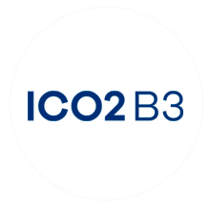
2
SUSTAINABILITY
Decarbonization and social value generation
OPERATIONAL AXES AND
¹
ENVIRONMENTAL COMMITMENTS
Sustainable operation
Low carbon technologies
Climate change and biodiversity
Short medium term 2025
Reduction of SF6¹ gas losses
Electrification of light vehicle fleet
Eliminate single-use plastic
Climate adaptation and transition plan
Expand the mapping of scope 3 emissions (construction of projects)
Long term 2030
Reduce 2 million tCO2e - Conexão Jaguar Program and eco-efficiency
Environmental management system certification for 100% of substations
Develop new technologies that help accelerate more efficient energy transition
¹SF6: Sulfur Hexafluoride

Slide 14
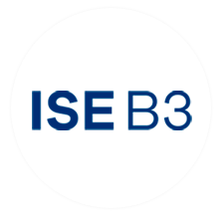
2
SUSTAINABILITY
Decarbonization and social value generation
OPERATIONAL AXES AND
SOCIAL COMMITMENTS
Health and safety
Inclusive education
Diversity Inclusion
Communities
Short medium term
Strive for zero accidents
Expand private social investments
Expand sustainability culture and volunteering initiatives
Expanding diversity in the focus pillars: gender, ethnic-racial, people with disabilities (PwDs) and LGBTI+
50% of women in Trainee and Internship Programs
1. Science, Technology, Engineering and Mathematics

Slide 15
VALUE LEVERS
GROWTH
Consistent and profitable
1
SUSTAINABLE VALUE GENERATION
6
2
OUR STRATEGY
SUSTAINABILITY
Decarbonization and social value generation
Create positive social and environmental impacts
REGULATORY MANAGEMENT
Active management with competitive advantage
Ensure business longevity
Creation of value for shareholders
3
5
INNOVATION
Provider of energy transition solutions
4
EXCELLENCE IN PROJECT MANAGEMENT
Disciplined structuring and execution

Slide 16
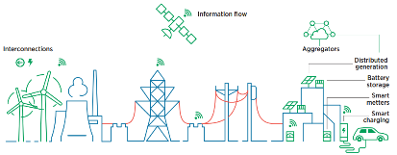
3
INNOVATION
Provider of energy transition solutions
OPERATIONAL FLEXIBILITY AND MODERNIZATION
OLD SCENARIO
NEW SCENARIO
Information flow
Interconnections
Aggregators
Distributed generation
Batteries
Smart meters
Electric vehicle chargers
Generation
Transmission
Distribution
Consumers
Generation
Transmission
Distribution
Prosumers
Energy flow
Energy flow
Predominance of conventional sources
Passive consumers
Solutions adopted do not eliminate idleness of the system
Predictable and stable environment
Low use of technological innovation
Renewable and variable sources
Active consumers (Prosumer)
Adoption of solutions that eliminate idleness of the system
Dynamic and less predictable environment
Intensification of technological innovation

Slide 17
3
INNOVATION
Provider of energy transition solutions
WE ARE A COMPANY
SOLUTIONS PROVIDER
FOR ENERGY TRANSITION
We observe the trends
And we create opportunities
Technologies
Market
Sector players
Startups
Regulation
New businesses
Energy transmission
Cross-cutting issues
Projects
Energy storage
Optimum project management
Employee safety
We align with 2030 Strategy
Structuring of offerings
ESG
Innovation governance
Initiative portfolio management
R&D, open innovation, intrapreneurship, training and culture
Excellence in O&M
Productivity in maintenance
Resilience and reliability

Slide 18
3
INNOVATION
Provider of energy transition solutions
Distributed Flexible AC Transmission System (D-FACTS)
INNOVATIVE PROJECTS AT THE FOREFRONT OF THE ENERGY SECTOR
Open Platform for Collaboration between Operational Centers in the Electricity Sector (ZACCX)
2023 1st Substation 4.0 in Brazil
Inclusion of New
Technologies
2022 1st large-scale battery storage project
2021 Brazil's 1st digital substation
Technological maturity
Research
Development
Commercial implementation

Slide 19
3
INNOVATION
Provider of energy transition solutions
BENEFITS AND CHALLENGES OF ENERGY STORAGE FOR THE
NATIONAL INTERCONNECTED SYSTEM (SIN)
Operational Benefits
Economic Benefits
Challenges
Greater system operational flexibility and reability
Greater use of non-dispatchable energy sources
Less dependence on hydroelectric plant reservoirs
Greater power reserve
Provision of ancillary services
Fast implementation
Lower operating costs
Better distribution of investments
Regulation of storage activities
More agile, integrated and flexible sector planning, considering all SIN requirements (energy, power and flexibility)
Promote economic competitiveness through tax equalization with other technologies that support the energy transition
Environmental Benefits
Reduction of greenhouse gas emissions
Enables greater insertion of renewable energy

Slide 20
3
INNOVATION
Provider of energy transition solutions
INTEGRATED PLANNING WITH THE EVOLUTION OF THE ENERGY TRANSITION
Management of risks and uncertainties
Market intelligence
Future challenges
R&D Integrated and flexible planning
R&D Market capacity for planned expansion
Supply chain analysis to drive transmission growth
Simulation of scenarios
Methodology for periodic monitoring
Recommendation of actions related to
supply chain, workforce training, environmental licensing and financing
Expansion plan portfolio to maximize flexibility and reliability of the electricity system
Computational simulation models geared to an environment of greater penetration of intermittent renewable energies

Slide 21
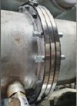
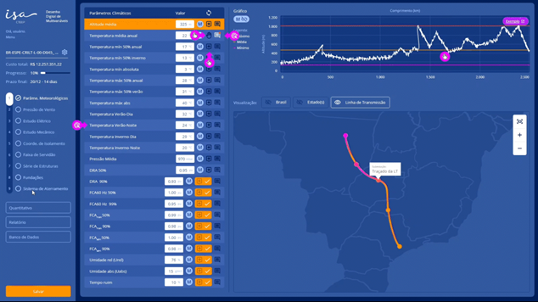
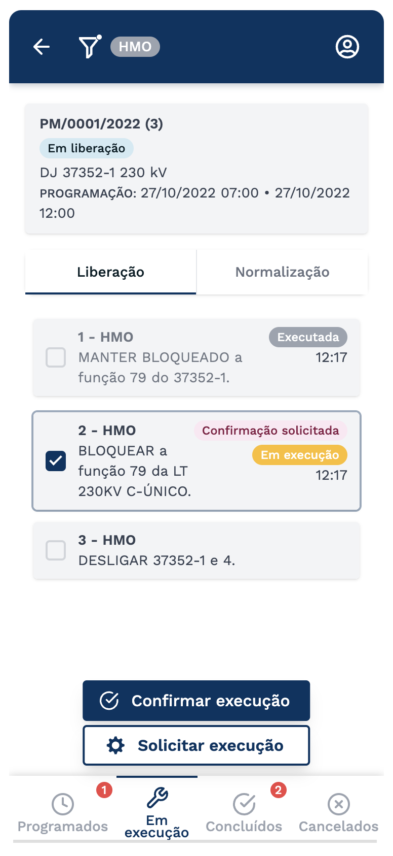
3
INNOVATION
Provider of energy transition solutions
GAINS IN COMPETITIVINESS highly EFFICIENCY and
LESS ENVIRONMENTAL IMPACT
Platform for communication between operators
52% reduction in operator time on the phone
41% reduction in maneuver execution time
Development of devices to contain SF6² gas
31% reduction in SF6² emissions (6,000 tCO2e avoided¹)
Platform for Optimized Development of Line Projects (Under development)
Reduces the time and cost for structuring projects
Increases competitiveness of new offerings
¹ In relation to 2021
² SF6: Sulfur hexafluoride

Slide 22
VALUE LEVERS
GROWTH
Consistent and profitable
1
SUSTAINABLE VALUE GENERATION
6
2
OUR STRATEGY
SUSTAINABILITY
Decarbonization and social value generation
Create positive social and environmental impacts
REGULATORY MANAGEMENT
Active management with competitive advantage
Ensure business longevity
Creation of value for shareholders
3
5
INNOVATION
Provider of energy transition solutions
4
EXCELLENCE IN PROJECT MANAGEMENT
Disciplined structuring and execution

Slide 23
4
EXCELLENCE IN PROJECT MANAGEMENT
Disciplined structuring and execution
STRUCTURING OF
TRANSMISSION AUCTIONS
Identification of opportunities and prioritization of projects
Strategy definition
Studies and Pre-
engineering
Risks
analysis
Preparation of schedules
Quotations and signing of contracts/
agreements
Risks
Validation
Efficient calculation and pre-contracting of CapEx¹
¹ Capital expenditure

Slide 24
4
EXCELLENCE IN PROJECT MANAGEMENT
Disciplined structuring and execution
A UCTION 01/2023
LOTS WON
LOT 1
LOT 9
SERRA DOURADA PROJECT
ÁGUA VERMELHA PROJECT
State Bahia and Minas Gerais
Transmission Lines 1,116 km
Jobs 5,739
ANEEL term 66 months
ANEEL Capex R$3.1 billion
RAP R$283.8 million
State Minas Gerais
Jobs 313
ANEEL Capex R$94 million
RAP R$7.8 million
ANEEL term 36 months
SS Juazeiro 3
SS Campo Formoso 3
SS Buritirama
SS Barra 2
SS Correntina
SS Arinos 2
SS Governador Valadares 6
LOT 7
SS Água Vermelha
SS Leopoldina 2
ITATIAIA PROJECT
SS Terminal Rio
State Rio de Janeiro and Minas Gerais
Transmission Lines 522 km in double circuit, totaling 1,044 km
ANEEL term 66 months
Jobs 4,182
ANEEL Capex R$2.3 billion
RAP R$218.9 million
Possibility of average advancement of between 12 and 24 months (vs. ANEEL term)
Bidded substation
Existing Substation
Solar
Wind

Slide 25
4
EXCELLENCE IN PROJECT MANAGEMENT
Disciplined structuring and execution
PORTFOLIO OF OWNED PROJECTS
UNDER EXECUTION
Serra Dourada
RAP: R$283.8 million¹
7 units under execution
Piraquê
2.7 mil km of transmission lines²
7.1 mil MVA in transforming capacity²
8 substation
CAPEX ANEEL R$10.6 billion
RAP R$972 million¹
RAP: R$313.5 million¹
Água Vermelha
Itatiaia
RAP: R$7.5 million¹
RAP: R$218.9 million¹
Jacarandá
Minuano
RAP: R$14.7 million¹
Riacho Grande
RAP: R$48.3 million¹
RAP: R$85.1 million¹
¹ Annual Permitted Revenue (RAP) cycle 2023/2024, proportional through ISA CTEEP’s participation
² Considers Project (100%)
Substation (SE)
Transmission Lines (TL)
Notes:
(unidades em construção – destacar leilões):

Slide 26
4
EXCELLENCE IN PROJECT MANAGEMENT
Disciplined structuring and execution
COMMITMENT TO CREATING SUSTAINABLE VALUE
Pipeline of investment projects
Evolution of investments¹
Projects authorized through 2028
R$ million
Retrofitting projects
R$5.0 billion
250 projects
R$15.6 billion
257 projects
Greenfield
R$10.6 billion
7 projects
CAGR³:
+49.5%
3,297
1,901
1,929
1,306
1,104
771
1,029
386
1,074
24
219
232
142
133
2018
2019
2020
2021
2022
2023
2024
2025
2026
2027
2028
Brownfield²
Greenfield
Retrofitting projects
¹ Cost of Construction, IFRS Accounting | ² Enterprise Value (EV) | ³ CAGR: Compound Annual Growth Rate

Slide 27
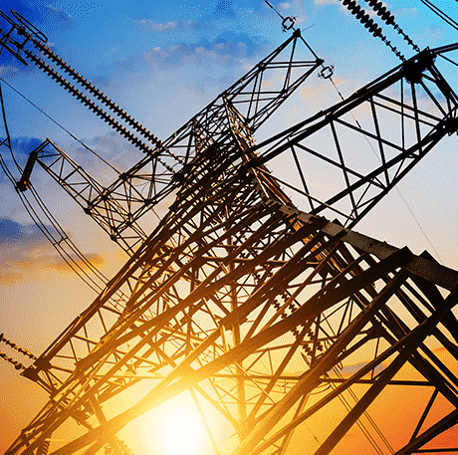
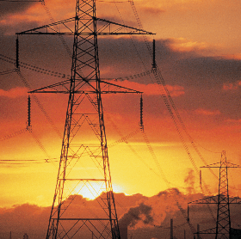
4
EXCELLENCE IN PROJECT MANAGEMENT
Disciplined structuring and execution
PROJECTS CONCLUDED
WITH EXCELLENCE IN CONSTRUCTION
Energized Projects
2019 - 2023
12
2019
Itapura Bauru
RAP²: R$13.5 million
Investment¹
R$ billion
3.8
2020
Itaquerê
RAP²: R$62.9 million
Tibagi
RAP²: R$21.5 million
RAP²
R$ million
644.8
2021
Aguapeí
RAP²: R$74.2 million
Itapura Lorena
RAP²: R$14.3 million
Biguaçu
RAP²: R$49.5 million
Reference in the sector:
Projects 100% controlled by ISA CTEEP concluded 7 months in advance³ and with average Capex efficiency of 37%⁴
Três Lagoas
RAP²: R$5.8 million
Ivaí (50%)
RAP²:
R$181.3 million
2022
Aimorés (50%)
RAP²: R$47.9 million
Paraguaçu (50%)
RAP²: R$66.8 million
2023
Itaúnas
RAP²: R$65.0 million
Triângulo Mineiro
RAP²: R$42.1 million
¹ Nominal (IFRS) Cost of Construction.
² RAP 23/24 cycle, weighted by ISA CTEEP's stake.
³ In relation to ANEEL's term.
⁴ Actual investment, baseline June/23, compared to ANEEL Capex.

Slide 28
VALUE LEVERS
GROWTH
Consistent and profitable
1
SUSTAINABLE VALUE GENERATION
6
2
OUR STRATEGY
SUSTAINABILITY
Decarbonization and social value generation
Create positive social and environmental impacts
REGULATORY MANAGEMENT
Active management with competitive advantage
Ensure business longevity
Creation of value for shareholders
3
5
INNOVATION
Provider of energy transition solutions
4
EXCELLENCE IN PROJECT MANAGEMENT
Disciplined structuring and execution

Slide 29
5
REGULATORY MANAGEMENT
Active management with competitive advantage
RTP
PERIODIC TARIFF REVIEW (RTP)
Outros
Administrative costs and Other revenues
Renewed Contract (059/2001)
E
(Weighted Capital Average Cost) WACC
Investment Remuneration
Review of Tariff Parameters every 5 years
RAP Improvements
Provisional Recipe for Improvements
Definition of Recipes for Reinforcements and Improvements
C
D
O&M
Coverage of Operation and Maintenance (O&M) Costs
Regulatory Remunaration Base (BRR) and Price Database (BP)
Final income from realized investments
A
B

Slide 30
5
REGULATORY MANAGEMENT
Active management with competitive advantage
PERIODIC TARIFF REVIEW (RTP)
Renewed Contract: competitive advantage and organic growth
Expectation of recognizing the level of efficiency in RTP
Regulatory Remunaration Base (BRR) and Price Database (BP)
RTP 2018 - Reinforcements and Improvements Investments (R&M) 2013 -2017
R$ million
+32%
Others
WACC
RAP Improvements
RTP 2023 - Investments R&M 2018 -2022
Investment (updated boook value) R$ 1,3 billion
RTP 2028 - Investimentos R&M 2023 -2027
Authorized Investments > R$ 5 billion
BRR BP
O&M
*Values in Jan/2023 database

Slide 31
5
REGULATORY MANAGEMENT
Active management with competitive advantage
PERIODIC TARIFF REVIEW (RTP)
O&M Costs Benchmarking
Expectation of Efficiency Award recognition
Operation and Mantainance (O&M)
RTP Public Consult
Signaling 117% O&M cost recognition
FATOR X:
Captures sectoral productivity across RTPs
Others
RAP TOTAL (R$ billion)
RAP Improvements
WACC
CAAE¹ 2.9
RAP Reajustment
(1+ IPCA)
BRR BP
O&M
O&M 0.8
(1+ IPCA – 0.812%)
*Values in Jan/2023 database
¹ Annal costs of electrical assets

Slide 32
5
REGULATORY MANAGEMENT
Active management with competitive advantage
PERIODIC TARIFF REVIEW (RTP)
RAP Melhorias
Tariff Regulation Procedures (PRORET) provides for regulatory annuity for small improvements with definitive review in the RTP (retroactive adjustment)
Revenue from Improvements between Tariff Cycles
RTP Public Consult
Does not include alternative proposal to PRORET
Others
Action Plan
Leadership in sectoral action to present a proposal to improve PRORET
RAP Improvements
WACC
BRR BP
O&M
*Values in Jan/2023 database

Slide 33
5
REGULATORY MANAGEMENT
Active management with competitive advantage
PERIODIC TARIFF REVIEW (RTP)
Investment Remuneration by Regulatory WACC
Maintained the 2018 calculation methodology for RTP 2023:
Variation from 2018 to 2023 = - 0,5 p.p main explanatory factor is the American beta
Capital structure: ~ 55% (equity), ~ 45% (third party capital)
Ke Shielding: historical series CAPM calculation (long window)
WACC (Weighted Average Cost of Capital)
WACC Regulatory¹
Others
RAP Improvements
WACC
BRR BP
O&M
*Values in Jan/2023 database

Slide 34
5
REGULATORY MANAGEMENT
Active management with competitive advantage
PERIODIC TARIFF REVIEW (RTP)
Others
Administrative Cost
The Company is efficient in relation to regulatory administrative costs
Public Consultation RTP recognizes additional value for Reinforcements of Tendered Contracts
Others
Impact: + R$ 1 million p.y.
WACC
Other Revenues
RAP Melhorias
Maintained the current methodology (PRORET)
Total value of current contracts:
R$ 18 million
BRR BP
O&M

Slide 35
VALUE LEVERS
GROWTH
Consistent and profitable
1
SUSTAINABLE VALUE GENERATION
6
2
OUR STRATEGY
SUSTAINABILITY
Decarbonization and social value generation
Create positive social and environmental impacts
REGULATORY MANAGEMENT
Active management with competitive advantage
Ensure business longevity
Creation of value for shareholders
3
5
INNOVATION
Provider of energy transition solutions
4
EXCELLENCE IN PROJECT MANAGEMENT
Disciplined structuring and execution

Slide 36
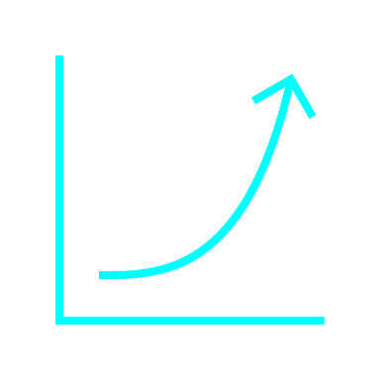
6
SUSTAINABLE VALUE GENERATION
OUTLOOK FOR
REVENUE GROWTH
Revenue growth with profitability and longevity
BIDDED
RETROFITTING PROJECTS
Double-digit real IRR for shareholders
RAP/CAPEX of 12% to 17%
Greater Longevity
Greater Profitability

Slide 37
6
SUSTAINABLE VALUE GENERATION
FIXED COSTS AND EXPENSES
CONTROLLED EVOLUTION
Operating efficiency
CAGR³:
+2.9%
85%
54%
48%
52%
49%
47%
46%
38%
40%
36%
2013
2014
2015
2016
2017
2018
2019
2020
2021
2022
Fixed Costs and Expenses² (R$ million)
Fixed Costs and Expenses / Net Operating Revenue (ex-RBSE)
Period CAGR¹ IPCA 6.1%
EBITDA MARGIN
jan/23 - jun/23
80%
NET MARGEIN
jan-jun/23
32%
Operating Cash Generation
jan-jun/23
R$ 1,5 billion
¹ CAGR: Compound Annual Growth Rate | ² Costs and expenses with personnel, material, services and others (PMSO)

Slide 38
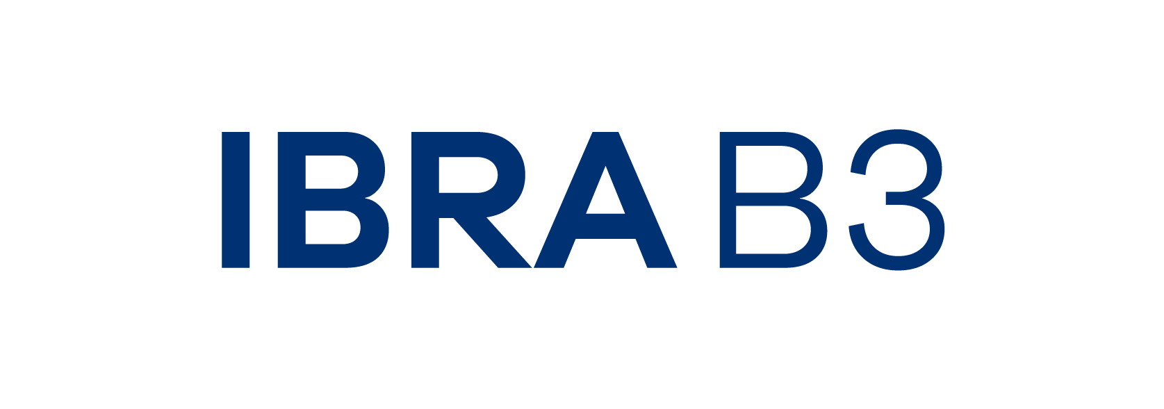
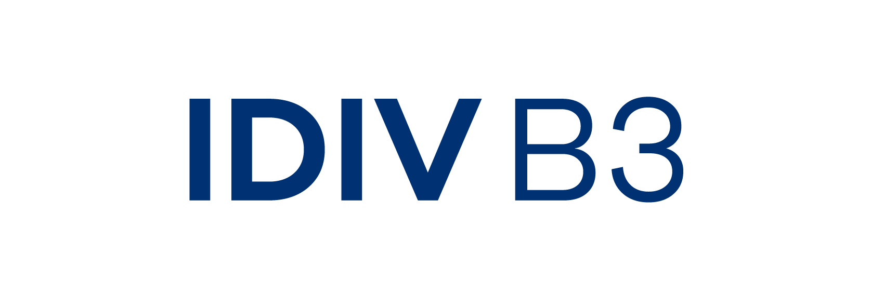
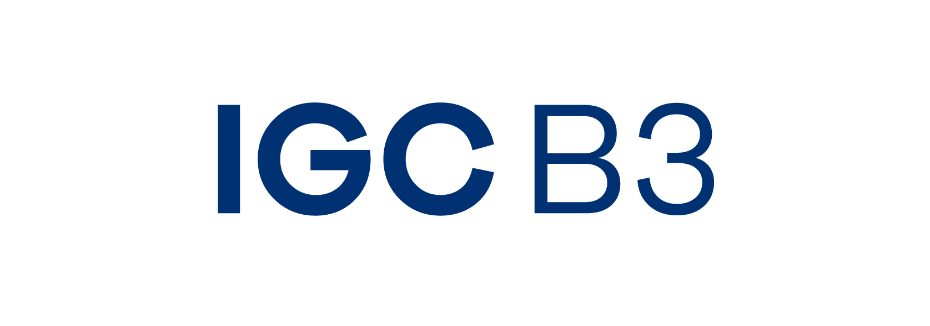
6
SUSTAINABLE VALUE GENERATION
STOCK PERFORMANCE
in the last decade
Stock appreciation
Shareholder remuneration
+ than R$15 reais
earnings per share distributed¹
(from 2013 to 2023)
¹ Real terms, database jun/23

Slide 39
6
SUSTAINABLE VALUE GENERATION
TOTAL RETURN TO SHAREHOLDER
IN THE LAST DECADE¹
4.869
2.461
1000
Average annual profitability¹
Peers² 13.4%
CDI 9.0%
Ibovespa 6.8%
IPCA 6.1%
18.5%
¹ consider reinvestment of dividends
² Exclusive energy transmission market peers
Notes:
Talking Points:
- Forte retorno total ao acionista, consideravelmente acima de outros indicadores como o IBOVESPA, CDI, IPCA e acima dos pares de mercado, considerando o reinvestimento dos proventos distribuídos no período.
- Transmissão não é renda fixa e tão pouco uma commoditie, para gerar o valor apresentado nos últimos anos pela Cia tem que conhecer o negócio, trabalhar com excelência na execução de projetos, fazer gestão adequada de temas regulatórios, inovar constantemente, buscar eficiência e alocação responsável dos recursos da Cia. Com equilíbrio no tripé de crescimento, rentabilidade e longevidade. Tudo isto pautado em sólido alicerce de governança e sustentabilidade.

Slide 40
VALUE LEVERS
GROWTH
Consistent and profitable
1
SUSTAINABLE VALUE GENERATION
6
2
OUR STRATEGY
SUSTAINABILITY
Decarbonization and social value generation
Create positive social and environmental impacts
REGULATORY MANAGEMENT
Active management with competitive advantage
Ensure business longevity
Creation of value for shareholders
3
5
INNOVATION
Provider of energy transition solutions
4
EXCELLENCE IN PROJECT MANAGEMENT
Disciplined structuring and execution

Slide 41
INVESTOR RELATIONS | TEAM
ri@isacteep.com.br
@isacteepbr
www.isacteep.com.br/ri

